Slide 1
introduction
What is reinforcement learning?
States and actions
Full observability and partial observability
policies
rewards
Extrinsic and intrinsic rewards
Rewards and environment transition distribution (model of env)
Immediate reward & return
What is expectation
What is Expected reward and return in sequential domains
Value functions
Different domains in reinforcement learning
Episodic and non-episodic & discount factor

Slide 2
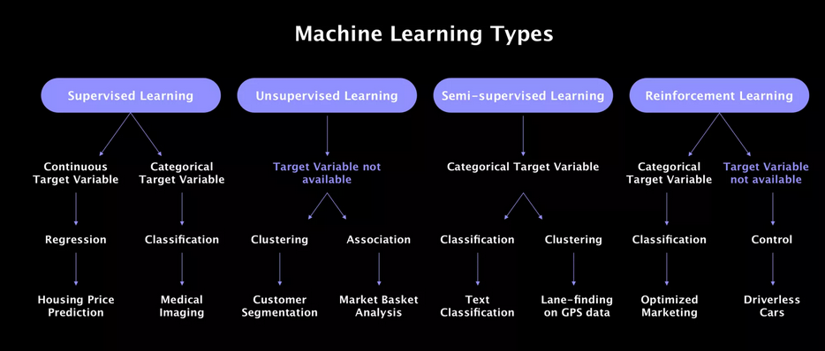

Slide 3
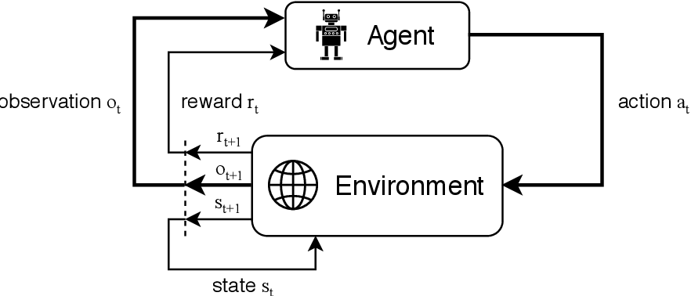

Robots locations are different but observations are the same
end
start
Best thing to do is to go up
Since agent does not see the state of env, it is not able to judge the best action
So, what should we do?
Best thing to do is go down

Slide 4
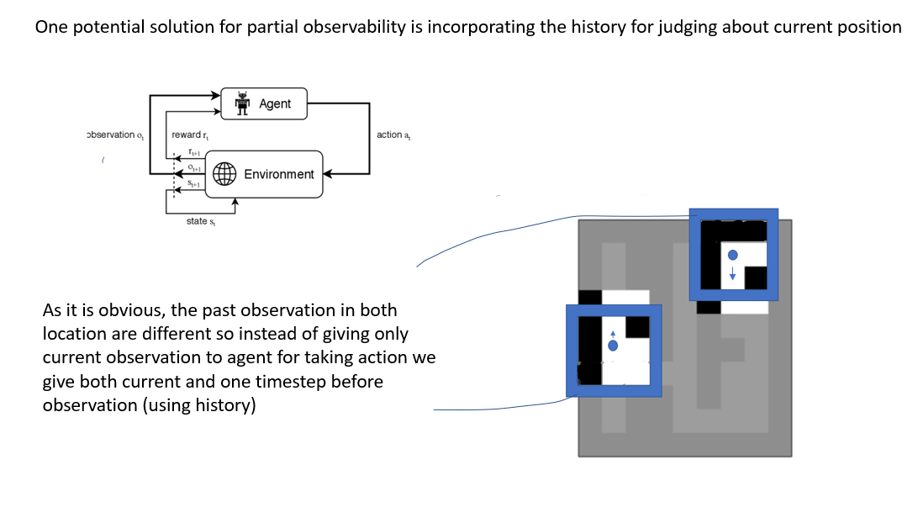

Slide 5
Stay at home (70%)
Information (10 TL budget for weekend)
Go buy a ice cream (20%)
This is policy
Go camping with friends (10%)

Slide 6
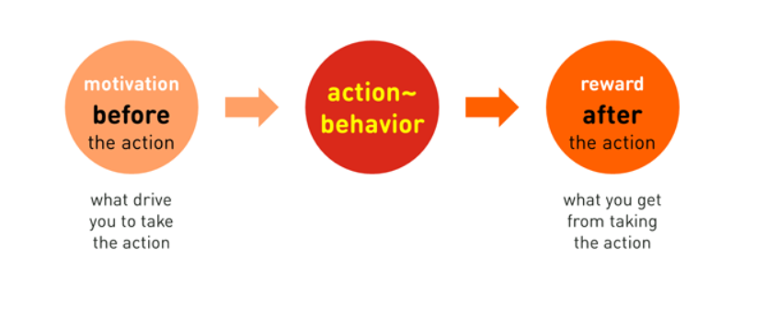
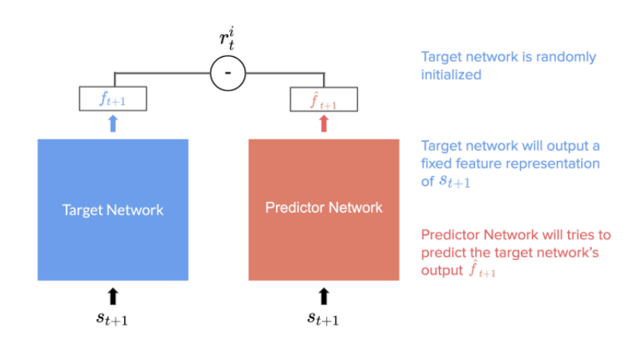
Extrinsic rewards : defined by knowledge domain
intrinsic rewards : we give agent an incentive to take some actions more than others
Especially : sparse reward environment
Curiosity-driven Exploration by Self-supervised Prediction
Random Network Distillation

Slide 7
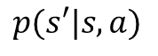
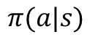
rewards :
Normal distribution
(b-a)/1
Uniform distribution
0
1
Fixed reward
0
Transition function
30%
5%
40%
30%
5%
Transition distribution
policy
90%
$$p(s′|s, a)$$
$$π(a|s)$$

Slide 8
Go to Istanbul for weekend
90% (end up in Istanbul)
90%
10% (end up in Izmir because Istanbul road is closed)
These are transitions
And we do not have any control on these
10%
Go to Izmir for weekend
This is policy

Slide 9
Uniform policy
Every step : +1 reward
Immediate reward : +1
50%
Return: +2
+1 reward
50%
We run one time : sampling
50%
+1 reward
50%
50%
50%
If we sample ∞ time and take average, that would be expected values (what are expected values?)

Slide 10
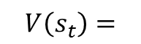
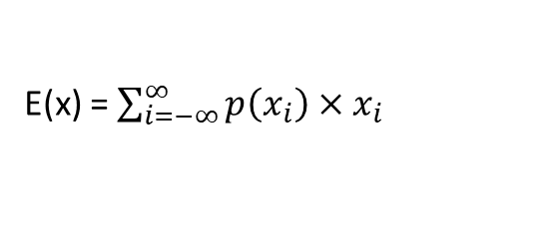
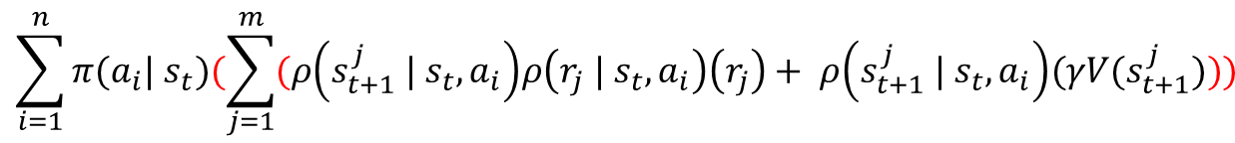
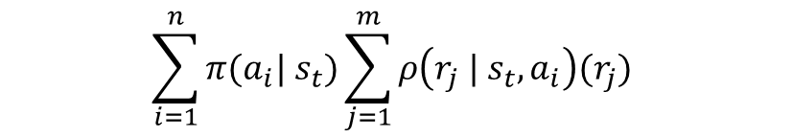
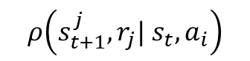
Expected value is equal to mean of distribution
Sampling from a distribution ∞ time and taking mean is expected value
Probability of occurrence of each event in random variable multiply in value of that occurrence is called expected value
E(x) = $\sum_{i=−∞}^{∞}{{p\left(x_{i}\right)×x}_{i}}$
.9 * (.9*1 + .1*.5) + .1 (.9 * 1 + .1 * .5) =
Expected value of immediate reward : E($R_{t}| s_{t})$
$$\sum_{i=1}^{n}{{π(a}_{i}| s_{t})\sum_{j=1}^{m}{ρ\left(r_{j} | s_{t}, a_{i}\right)(r_{j})}}$$
Reinforcement learning :
Do the same calculation for this
Expected value Return : E($G_{t})$
$$ρ\left(s_{t+1}^{j},r_{j}| s_{t}, a_{i}\right)$$
$$\sum_{i=1}^{n}{{π(a}_{i}| s_{t})(\sum_{j=1}^{m}{(ρ\left(s_{t+1}^{j} | s_{t}, a_{i}\right)ρ\left(r_{j} | s_{t}, a_{i}\right)\left(r_{j}\right)+ ρ\left(s_{t+1}^{j} | s_{t}, a_{i}\right)(γV(s_{t+1}^{j})}}))$$
$$V\left(s_{t}\right)=$$
Expected return in next current state
Most of the time reward not come from distribution and is fixed so this term is 1

Slide 11
We assume that reward is fixed to +1 for any transition but it can come from a distribution
V(S) = 4
90%
We assume transition distribution for reaching to goal state is .9 and for other states are .1
Policy is 50%, 50% for two of actions
Discount factor is 1
50%
10%
V(S) = 0
10%
50%
90%
V(S) = 3
First action:
$$0.5 ×((0.9 ×1)+(0.1 ×1)$$
Expected reward is:
Sum
= 1
$$0.5 ×((0.9 ×1)+(0.1 ×1)$$
second action:
First action:
$$0.5 ×((0.9 ×1+0.9 ×1 ×4)+(0.1 ×1+0.1 ×1 ×3)$$
Expected return is:
Sum
= 0/445
second action:
$$0.5 ×((0.9 ×1+0.9 ×1 ×3)+(0.1 ×1+0.1 ×1 ×4)$$

Slide 12
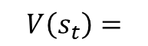
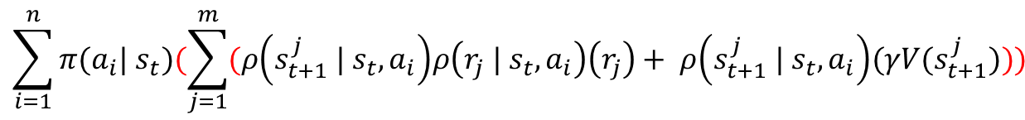
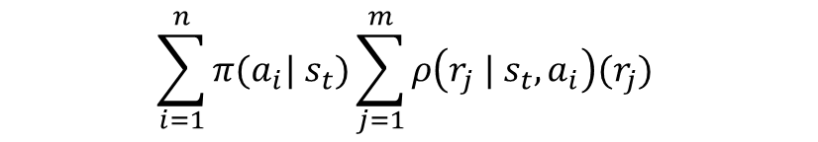
have model of environment : reward distributions and transition function
Expected value of immediate reward : E($R_{t})$
$$\sum_{i=1}^{n}{{π(a}_{i}| s_{t})\sum_{j=1}^{m}{ρ\left(r_{j} | s_{t}, a_{i}\right)(r_{j})}}$$
Expected value Return : E($G_{t})$
Expected values
$$\sum_{i=1}^{n}{{π(a}_{i}| s_{t})(\sum_{j=1}^{m}{(ρ\left(s_{t+1}^{j} | s_{t}, a_{i}\right)ρ\left(r_{j} | s_{t}, a_{i}\right)\left(r_{j}\right)+ ρ\left(s_{t+1}^{j} | s_{t}, a_{i}\right)(γV(s_{t+1}^{j})}}))$$
$$V\left(s_{t}\right)=$$
Do Not have model of environment : reward distributions and transition function
Sampling and take average

Slide 13
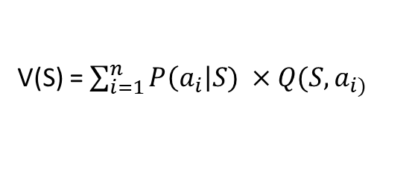
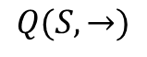
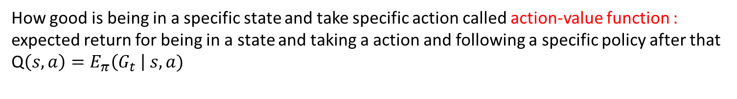
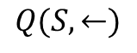
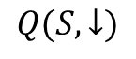
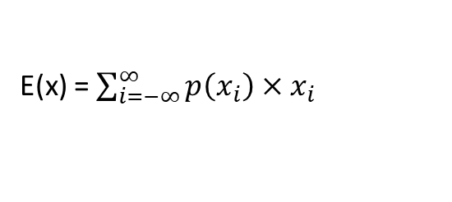
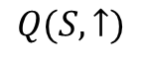
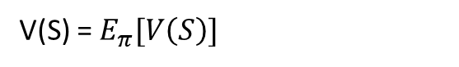
How good is being in a specific state called value function :
expected return for being in a state and following a specific policy
$V\left(s\right)=E_{π}\left(G_{t} \right| s)$
How good is being in a specific state and take specific action called action-value function : expected return for being in a state and taking a action and following a specific policy after that
Q$\left(s,a\right)=E_{π}\left(G_{t} \right| s, a)$
E(x) = $\sum_{i=−∞}^{∞}{{p\left(x_{i}\right)×x}_{i}}$
V(S) = $\sum_{i=1}^{n}{P\left(a_{i}\right|S) ×Q(S, a_{i)}}$
30 %
V(S) = $E_{π}[V\left(S\right)]$
$$Q(S, ↑)$$
10%
$$Q(S, ←)$$
V(S)
$$Q(S, →)$$
20 %
$$Q(S, ↓)$$
40%
From policies

Slide 14
Policy or Value Function → what is goal?
In Reinforcement Learning our end goal is finding optimal policies and for every problem we can find a deterministic optimal policy.
There are two ways to reach optimal or sub-optimal policies:
1- directly find policies : policy gradient methods
* give us stochastic policies → (why do we need stochastic policies)
* for continues action spaces
2- indirectly find policies : first find best state-value and action-state values for some policy (policy evaluation) then improve policy based on new state-values or action-state-values (policy improvement), and again this cycle go to find optimal policy
value function methods (Monte Carlo, TD Learning, Q-Learning)
* many efficient algorithm have been proposed in this area
* just for distinct action spaces

Slide 15
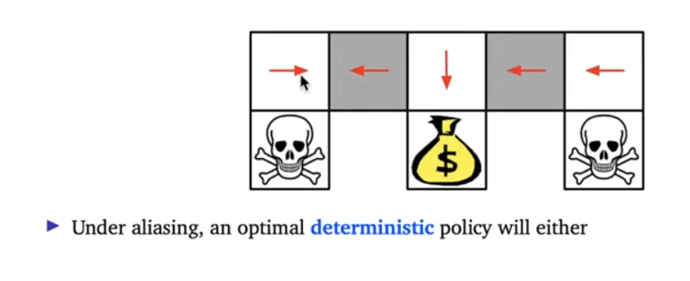
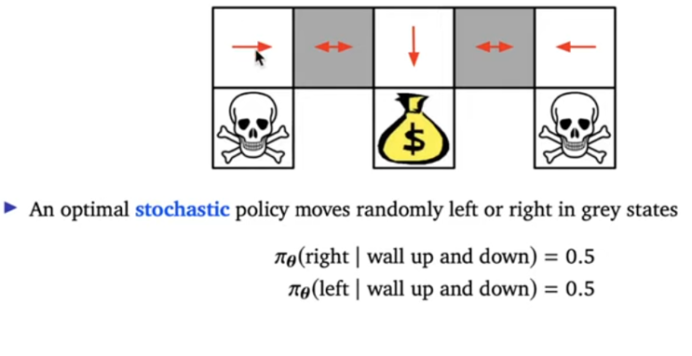
Stuck in here
Partial observability

Slide 16
Episodic : reaching end state means end of run
end
robot
Continue forever
food
If the environment do not end, how can we calculate expected values – how far we should continue in time?
Solution : using discount factor $γ$

Slide 17
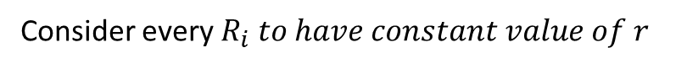
Discount factor
$V\left(s\right)=E_{π}\left(G_{t} \right| s)= E_{π}\left(R_{t}+R_{t+1}+R_{t+2}+R_{t+3}+R_{t+4}+R_{t+5}+R_{t+6}+ …\right| s)$
$V\left(s\right)=E_{π}\left(G_{t} \right| s)= E_{π}\left(R_{t}+{γR}_{t+1}+γ^{2}R_{t+2}+γ^{3}R_{t+3}+{γ^{4}R}_{t+4}+{γ^{5}R}_{t+5}+{γ^{6}R}_{t+6}+…\right| s)$
Consider every $R_{i} to have constant value of r$
$V\left(s\right)=E_{π}\left(G_{t} \right| s)= E_{π}\left(r+γr+γ^{2}r+γ^{3}r+γ^{4}r+ …..\right| s)$
This is geometric series
$V\left(s\right)=E_{π}\left(G_{t} \right| s)= E_{π}\left(\frac{r}{1 − γ}\right| s)$
This term has a constant value → so, infinite horizon become finite horizon

Slide 18
Important concepts
Population and sample
Distribution of the mean (unbiased estimate of population param)
Normal sampling(biased estimate of population param)
Multi-arm bandit
Exploration and exploitation
policies
Greedy policy – epsilon greedy policy
Any normal policy ∏ (like random policy)
Methods for exploration
Optimistic initial action functions
Upper bound confidence

Slide 19
Sample distribution of the mean
Real distribution
Sample size
Take n sample and take average : $x_{1}$
This is unbiased estimation of actual distribution’s mean or true expected value if sample size be high enough
Take n sample and take average : $x_{2}$
Take n sample and take average : $x_{3}$
Take n sample and take average : $x_{n}$
Sample distribution of the mean is always normal with its mean equal to true value of the mean and std equal to true std divided by square of sample size
Every value is a mean of sample

Slide 20
Distribution of reward

Slide 21
Is the green one the best choice? We can not tell yet
Can we generalize our samples to real values of our actions?
No, we do not have enough samples to map a distribution

Slide 22
Increasing Sample size == more closer to getting expected rewards of a specific action
We can map each of these to a distribution

Slide 23
Our sampling
Real population
bias
We believe expected reward is here
If we stop sampling here, we would have bias

Slide 24
Sample distribution
Real distribution
bias
Confidence interval (95% we are sure that expected reward is in this area)

Slide 25
Sample distribution
Real distribution
More sample – less bias
What if we sample ∞ time

Slide 26
pdf
Expected reward
Sample ∞ time : less bias and better estimation of expected reward

Slide 27
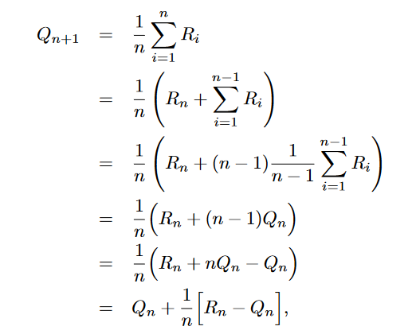
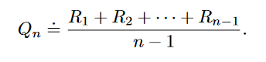
Expected value with sampling : incremental method
Taking moving average for finding expected values transform to this equation (very important equation)

Slide 28
In this phase : we believe the best action is green button
If we follow different policies what would happen?

Slide 29
If we act greedily, we will never find the best button, which is black button and we always choose green one
Greedy policy
If we act random, we might find the expected reward for each of actions, but after finding these values, we will not exploit from our knowledge of environment (unless in some point, take policy improvement step after policy evaluation phase)
random
Any policy ∏
There is always a factor of exploration but simultaneously, there is always a factor of randomness in our actions just like random policies (this will have poor performance in comparison with decaying epsilon
Fixed epsilon
€-Greedy policy
At first we try to explore with epsilon factor and after gaining enough knowledge about environment, act greedily to exploit our information
Decaying epsilon

Slide 30
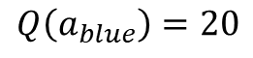
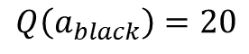
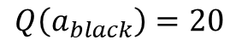
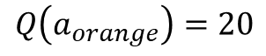
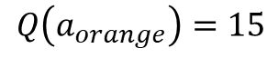
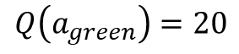
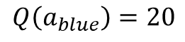
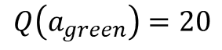
Initial optimistic values as a way to exploration:
Get 10
Act greedily
update
$$Q\left(a_{orange}\right)=15$$
$$Q\left(a_{orange}\right)=20$$
$$Q\left(a_{black}\right)=20$$
$$Q\left(a_{black}\right)=20$$
$$Q\left(a_{blue}\right)=20$$
$$Q\left(a_{blue}\right)=20$$
$$Q\left(a_{green}\right)=20$$
$$Q\left(a_{green}\right)=20$$
Again act greedily

Slide 31
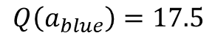
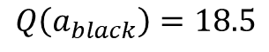
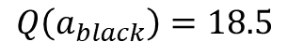
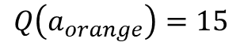
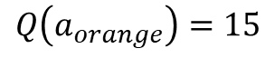
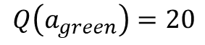
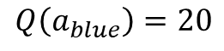
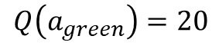
$$Q\left(a_{orange}\right)=15$$
$$Q\left(a_{orange}\right)=15$$
Get 17
$$Q\left(a_{black}\right)=18.5$$
$$Q\left(a_{black}\right)=18.5$$
Get 15
$$Q\left(a_{blue}\right)=20$$
$$Q\left(a_{blue}\right)=17.5$$
$$Q\left(a_{green}\right)=20$$
$$Q\left(a_{green}\right)=20$$

Slide 32
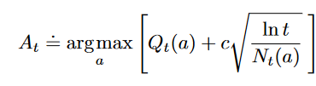
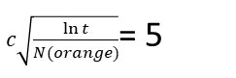
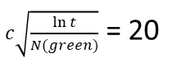
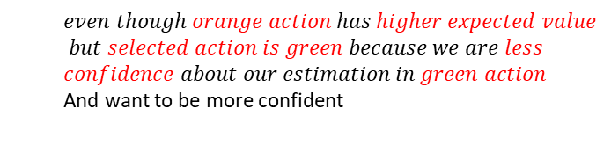
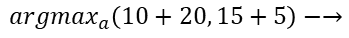
Weight of this term
Number of time a action selected
Consider a situation that after sampling we have reached these distributions in 2-arm bandit
$c\sqrt{\frac{\ln{t}}{N(orange)}}$= 5
These are confidence intervals
$c\sqrt{\frac{\ln{t}}{N(green)}}$ = 20
Q(green) = 10
Mean of distributions
Q(green) = 15
Higher values for upper confidence means less confidence about our estimation
$even though orange action has higher expected value$
$$but selected action is green because we are less$$
$confidence about our estimation in green action$
And want to be more confident
$${argmax}_{a}\left(10+20, 15+5\right)−→$$

Slide 33
We take action (green)
Update distribution
Confidence levels decrease
Our expected value for Q(green) has increased and upper confidence for green has decreased (N(green) increase and upper confidence decrease)

Slide 34
Dynamic programming
Markov decision process
Optimal state and state-action values
Bellman expectation and optimality equations
policy iteration
Policy evaluation & improvement
Value iteration
Generalized policy iteration
Different types of dynamic programming

Slide 35
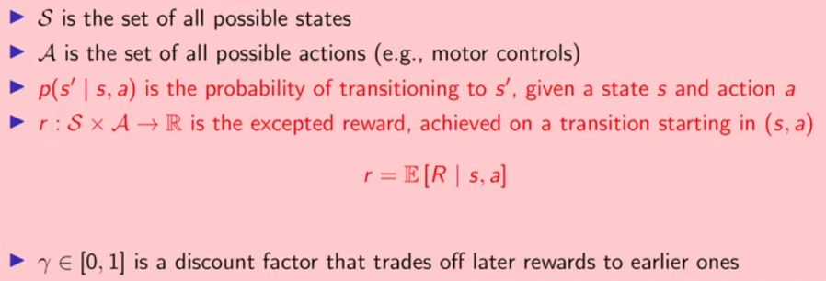


Markov decision process : it is just a framework and a decision is Markov if it has Markov property
Markov property
$$p\left(R_{t+1}, S_{t+1}\right| S_{t}, A_{t})=p\left(R_{t+1}, S_{t+1}\right| H_{t}, A_{t})$$
history
$S_{t−1}$, $R_{t−1}$, $A_{t−1}$, $S_{t−2}$, $R_{t−1}$, $A_{t−1}$, $S_{t−3}$, ….
* It does not matter put our current state in equation or experienced history since $S_{t}$ contain all information of past inside itself and once we have current state, we can throw away history ------ $S_{t}$ = $H_{t}$
Tuple of (S, A, $ρ, r, γ)$
Markov decision process :

Slide 36
environments like this where we do not have access to environment’s full state, instead of Markov decision process we would have partial observable Markov decision process
POMDP not MDP

Slide 37




3
6
50%
60%
$$π_{1}$$
$$π_{2}$$
2.8
7
50%
8
40%
4
Following this policy, all states’ values are higher in comparison with the other policy

Slide 38

In value function methods : Our goal is finding optimal state-action values and then extracting optimal policies from them.
* Important notes:
Different value function can reach to the same greedy policy:
We will use this in policy improvement
6
3
7
5
6
2
8
7

Slide 39
* Important notes:
There can be more than one deterministic optimal policy
6
7
s
8
8
First policy
second policy
If we assume that these are optimal state-action values, then going picking right or down separate into two different optimal policy for this state

Slide 40








Expected value of immediate reward : E($R_{t}| s_{t})$
$$\sum_{i=1}^{n}{{π(a}_{i}| s_{t})\sum_{j=1}^{m}{ρ\left(r_{j} | s_{t}, a_{i}\right)(r_{j})}}$$
Reinforcement learning :
Expected value Return : E($G_{t})$
$$\sum_{i=1}^{n}{{π(a}_{i}| s_{t})(\sum_{j=1}^{m}{(ρ\left(s_{t+1}^{j} | s_{t}, a_{i}\right)ρ\left(r_{j} | s_{t}, a_{i}\right)\left(r_{j}\right)+ ρ\left(s_{t+1}^{j} | s_{t}, a_{i}\right)(γV(s_{t+1}^{j})}}))$$
$$V_{π}\left(s_{t}\right)=$$
$$\sum_{i=1}^{n}{{π(a}_{i}| s_{t})(\sum_{j=1}^{m}{(ρ\left(s_{t+1}^{j} | s_{t}, a_{i}\right)ρ\left(r_{j} | s_{t}, a_{i}\right)\left(r_{j}\right)+ ρ\left(s_{t+1}^{j} | s_{t}, a_{i}\right)(γV(s_{t+1}^{j})}}))$$
$$V_{π}\left(s_{t}\right)=$$
Bellman expectation equations :
$$\sum_{j=1}^{m}{(ρ\left(s_{t+1}^{j} | s_{t}, a\right)ρ\left(r_{j} | s_{t}, a\right)\left(r_{j}\right)+γρ\left(s_{t+1}^{j} | s_{t}, a\right)\sum_{i=1}^{n}{{π(a}_{i}| s_{t+1})}}$$
$$Q_{π}\left(s_{t},a_{t}\right)=$$
$Q_{π}\left(s_{t+1},a_{i}\right)$)

Slide 41





$$V^{∗}\left(s_{t}\right)=$$
$\max_{a}[\sum_{j=1}^{m}{(ρ\left(s_{t+1}^{j} | s_{t}, a\right)ρ\left(r_{j} | s_{t}, a\right)\left(r_{j}\right)+ ρ\left(s_{t+1}^{j} | s_{t}, a\right)(γV\left(s_{t+1}^{j}\right))}$]
Bellman optimality equations :
$$\sum_{j=1}^{m}{(ρ\left(s_{t+1}^{j} | s_{t}, a\right)ρ\left(r_{j} | s_{t}, a\right)\left(r_{j}\right)+γρ\left(s_{t+1}^{j} | s_{t}, a\right)\max_{a′}}$$
$$Q^{∗}\left(s_{t},a_{t}\right)=$$
$Q_{π}\left(s_{t+1},a′ \right)$)

Slide 42


$$\sum_{i=1}^{n}{{π(a}_{i}| s_{t})(\sum_{j=1}^{m}{(ρ\left(s_{t+1}^{j},r_{j}| s_{t}, a_{i}\right)\left(r_{j}\right)+ ρ\left(s_{t+1}^{j} | s_{t}, a_{i}\right)(γV(s_{t+1}^{j})}}))$$
$$V_{π}\left(S_{t}\right)=$$
Apply this equation to all of the states
$$∞ time$$
Policy evaluation: reaching to optimal state value for a specific policy

Slide 43



Slide 44


Different value function can reach the same greedy policies
Acting greedily will give us a new policy to evaluate

Slide 45



If we act greedily in each state and then follow the previous policy from there:
If we prove this:
then we have improved our policy

Slide 46


$$π′\left(s_{t}\right)=$$
${argmax}_{a}[\sum_{j=1}^{m}{(ρ\left(s_{t+1}^{j},r_{j} | s_{t}, a\right)\left(r_{j}\right)+ ρ\left(s_{t+1}^{j} | s_{t}, a\right)(γV\left(s_{t+1}^{j}\right))}$]
Bellman optimality equation
Just one difference : argmax instead of max
Bellman expectation equation
Policy evaluation (n time)
Policy iteration:
Policy improvement (1 time)
Bellman optimality equation

Slide 47
We can see that at this point we can do policy improvement phase
We do not need to go to the infinity
We can even do the policy improvement part in k=1
Considering this fact
this is value iteration

Slide 48






Value iteration: incorporate policy evaluation and policy improvement in one equation
$V_{π}$)S) → $V_{π}^{∗}$)S)
Policy evaluation
find
Policy improvement
$$π^{′}$$
Policy iteration:
$V_{π^{′}}$)S)
find
Do first evaluation for the optimal policy
$V_{π′}$)S) → $V_{π′}^{∗}$)S)
Policy evaluation
Value iteration combine these 2 step
$$V_{k+1}\left(s_{t}\right)=$$
$\max_{a}[\sum_{j=1}^{m}{(ρ\left(s_{t+1}^{j},r_{j} | s_{t}, a\right)\left(r_{j}\right)+ ρ\left(s_{t+1}^{j} | s_{t}, a\right)(γV\left(s_{t+1}^{j}\right))}$]
Bellman optimality equation

Slide 49
Different types of Dynamic Programming
Synchronous Dynamic Programming: store 2 value for each state old and new
Update this with old values (with 1 not 7)
1
2
1
2
2
1
2
7
3
4
4
3
3
4
4
3
1
2
1
2
7
18
7
18
7
18
7
18
3
4
4
3
4
21
12
21
21
3
12
12

Slide 50
Different types of Dynamic Programming
Asynchronous in-place Dynamic Programming: store 2 value for each state old and new
Update this with old values (with 1 not 7)
1
2
7
2
3
4
3
4
7
21
7
21
7
21
3
4
32
4
32
3

Slide 51
Importance sampling
Monte Carlo == TD(∞)
Model free
evaluation and control
On-policy evaluation & off-policy evaluation
On-policy control & off-policy control
TD(0)
evaluation and control
On-policy TD(0) evaluation
On-policy TD(0) control and off-policy TD(0) control
SARSA & Q-Learning
Expected SARSA
Double learning
n-step methods
TD(n) → on policy evaluation
SARSA(n) → on-policy and off-policy control
Lambda methods
Forward-view & backward-view (eligibility traces)

Slide 52


Importance sampling
If we have random variable X, which comes from distribution d and a function f that we want to calculate expected value of this function under sampling from distribution d – ${\text{E}}_{x\sim d}$ [f(x)].
but if we do not have access to distribution d, we can estimate the expectation of f(X) by sampling from distribution d’, which is available to us.
Target policy
d(x) = how likely is occurrence of x under distribution d
We call this ratio :
d’(x) = how likely is occurrence of x under distribution d’
In reinforcement learning : behavior policy

Slide 53


d’
d
We sample from this
d’(x) for the point that we have sampled from d’ is very low and d’(x) is in denominator and make ratio bigger
$$\frac{d(x)}{d′(x)}$$
$$\frac{d(x)}{d′(x)}$$
d(x) for the point that we have sampled from d’ is very high and d(x) is in nominator and make ratio bigger
Scale up the events that are rare in d’ and common in d
Because we value distribution of d not d’

Slide 54
d’
d
We sample from this
d’(x) for the point that we have sampled from d’ is very high and d’(x) is in denominator and make ratio lower
$$\frac{d(x)}{d′(x)}$$
$$\frac{d(x)}{d′(x)}$$
d(x) for the point that we have sampled from d’ is very low and d(x) is in nominator and make ratio lower
Scale down the events that are common in d’ and rare in d
Because we value distribution of d not d’

Slide 55




Monte Carlo Method: for estimating state-value functions, this method suggests that we do sampling many times for a specific state s and follow policy $π$ onward and take average.
Monte Carlo methods do sampling by waiting to the end of episode and as it is obvious are for episodic settings
First run : $G_{1}$ = 15
s
second run : $G_{2}$ = 25
s
Monte Carlo method: $\frac{G_{1}+G_{2}}{2}$
More sampling better estimation

Slide 56

First sample return
Expected value
Second sample return
In monte Carlo we can use this

Slide 57

Monte Carlo prediction for estimating V(S)

Slide 58
Important note : if we have model of environment, by estimating optimal V(S) we can extract policy but what if we do not have access to the dynamics: we should estimate Q(S,A) values.
But for estimating Q(S,A) values, we have one major problem when our policy is greedy:
If we give arbitrary initial values for Q(S,A) an act greedily
2
10
Acting greedily
5
4
if updated value increases, next time, again this action in this state will be chose and this will continue to reaching optimal value of this state-action value
But what if optimal value for state-action for taking action down is better but we have not explored? Solution : exploring states : we put our agent randomly in environment by assuming that in that initial state, agent have taken a specific action and then follow a policy

Slide 59

Monte Carlo prediction for estimating Q(S,A)
Exploring start states is implemented in here
Everything is the same as Monte Carlo prediction for estimating Q(S,A) except exploring start line and replacing V(S) with Q(S,A)

Slide 60


policy iteration cycle
value iteration cycle : incorporate evaluation and improvement in one equation
Monte Carlo control methods follow value iteration cycle
Monte Carlo on-policy control for Q(S,A)
Use exploring start
Only difference with Monte Carlo prediction for estimating Q(S,A) is this policy improvement term
Evaluation and control in one step

Slide 61

policy iteration cycle
value iteration cycle : incorporate evaluation and improvement in one equation
Monte Carlo control methods follow value iteration cycle
Monte Carlo on-policy control for Q(S,A) (exploring with decaying epsilon-greedy instead of exploring states

Slide 62
Expected value with sampling : incremental method
Taking moving average for finding expected values transform to this equation (very important equation)

Slide 63



Off-policy Monte Carlo methods
Applying incremental method in Monte Carlo:
If we have sampled $G_{1},G_{2}$, $G_{3}, ….,G_{n−1}$ for one specific state, we can use weighted (importance sampling) moving average to come up with equation for incremental update of Monte Carlo:
These weights are $\frac{d(x)}{d′(x)}$ for the whole trajectory
$$V_{n}= \frac{\sum_{ k=1}^{n−1}{W_{k}G_{k}}}{\sum_{ k=1}^{n−1}{W_{k}}}$$
$$W_{k}= \frac{π\left(a_{t}\right|s_{t})π\left(a_{t+1}\right|s_{t+1})π\left(a_{t+2}\right|s_{t+2})……. }{b\left(a_{t}\right|s_{t})b\left(a_{t+1}\right|s_{t+1})b\left(a_{t+2}\right|s_{t+2})…….}$$
$V_{n+1}= \frac{\sum_{ k=1}^{n}{W_{k}G_{k}}}{\sum_{ k=1}^{n}{W_{k}}}$ = $\frac{W_{n}G_{n}+ \sum_{ k=1}^{n−1}{W_{k}G_{k}}}{\sum_{ k=1}^{n}{W_{k}}}$= $\frac{W_{n}G_{n}+V_{n}\sum_{ k=1}^{n−1}{W_{k}}}{\sum_{ k=1}^{n}{W_{k}}}$ = $\frac{{W_{n}V_{n}{ − W}_{n}V_{n}+W}_{n}G_{n}+V_{n}\sum_{ k=1}^{n−1}{W_{k}}}{\sum_{ k=1}^{n}{W_{k}}}$ = $\frac{{{ − W}_{n}V_{n}+W}_{n}G_{n}+V_{n}({ W}_{n}+\sum_{ k=1}^{n−1}{W_{k})}}{\sum_{ k=1}^{n}{W_{k}}}$
$V_{n+1}$= $\frac{{{ − W}_{n}V_{n}+W}_{n}G_{n}+V_{n}(\sum_{ k=1}^{n}{W_{k}})}{\sum_{ k=1}^{n}{W_{k}}}$ = $V_{n}$ + $\frac{{{ − W}_{n}V_{n}+W}_{n}G_{n}}{\sum_{ k=1}^{n}{W_{k}}}$ = $V_{n}$ + $\frac{{ W}_{n}(G_{n}−{ V}_{n})}{\sum_{ k=1}^{n}{W_{k}}}$ = $V_{n}$ + $\frac{{ W}_{n}}{\sum_{ k=1}^{n}{W_{k}}}$ $×$[$(G_{n}−{ V}_{n})$] →
$V_{n+1}$= $V_{n}$ + $\frac{{ W}_{n}}{\sum_{ k=1}^{n}{W_{k}}}$ $×$[$(G_{n}−{ V}_{n})$] → $V_{n+1}$= $V_{n}$ + $\frac{{ W}_{n}}{C_{n}}$ $×$[$(G_{n}−{ V}_{n})$]

Slide 64

Monte Carlo off-policy prediction for Q(S,A) (using importance sampling)
We only have probabilities for actions in a given states
We behave based on behavior policy

Slide 65

Monte Carlo off-policy control for Q(S,A) (using importance sampling)

Slide 66



First sample return
Expected value
Second sample return
reminder
online : just look one step ahead
TD(0)
$$G_{t}$$
Offline : wait till the end of eps
Monte Carlo

Slide 67


TD(0) on-policy evaluation for V(S)
TD(0) on-policy control for Q(S, A) → SARSA algorithm
Value iteration
Policy evaluation and policy improvement :
If use anything except $ε−greedy, policy evaluation$

Slide 68

If replace this equation, we will have →
TD(0) off-policy evaluation for V(S)

Slide 69


TD(0) off-policy control for Q(S, A) → Q-learning
Behavior policy
Greedy policy is our target policy
Value iteration
Why there is no importance sampling
This A, is determined beforehand and not come from policy, so importance sampling $\frac{b(a|s)}{π(a|s)}$ is 1.
*important note:
$Q\left(S,A\right)=\frac{b(a|s)}{π(a|s)}$Q(S,A) + $α(…..)$

Slide 70

TD(0) off-policy evaluation for Q(S, A) → Expected SARSA
replace
Less variance than SARSA because of break randomness in SARSA

Slide 71

Double Q-learning
All algorithms with operator max such as SARSA and Q-learning suffer from the problem of overestimation
Terminal state
From A, Right action’s expected return is 0
From A, left action’s expected return is -0.1
All the action in here have a reward distribution of normal with mean -0.1 and standard deviation 1

Slide 72

Q($S_{A}$, right) = Q($S_{A}$, right) + step-size $×(0+{\text{max}}_{a}\text{Q}\text{(}S_{terminal}\text{, }\text{.)}−\text{Q}\text{(}S_{A}\text{, }\text{right}\text{)}$)
Value form initial chosen value for $\text{Q}\text{(}\text{S}\text{, }\text{right}\text{)}$, by passing time, converge to 0
Q($S_{A}$, right) = Q($S_{A}$, right) + step-size $×(−\text{Q}\text{(}S_{A}\text{, }\text{right}\text{)}$) =
Q($S_{A}$, right)(1 – step-size) = Q($S_{A}$, right)(1 – step-size) + step-size $×(−\text{Q}\text{(}S_{A}\text{, }\text{right}\text{)}$) -> this will converge to 0
Q($S_{A}$, right)
Initial value
time
Q(S, right)
Q($S_{A}$, left) = Q($S_{A}$, left) + step-size $×(0+{\text{max}}_{a}\text{Q}\text{(}S_{B}\text{, }\text{a}\text{)}−\text{Q}\text{(}S_{A}\text{, }\text{left}\text{)}$)
Initial value
${take a}_{1}=reward from normal distribution of \left(−0.1, 1\right)=−0.5$
time
${take a}_{2}=reward from normal distribution of\left(−0.1, 1\right)$ = -0.8
${take a}_{3}=reward from normal distribution of\left(−0.1, 1\right)$ = 0.8
This is chosen action
Q($S_{A}$, left) = Q($S_{A}$, left) + step-size $×(0+0.8−\text{Q}\text{(}S_{A}\text{, }\text{left}\text{)}$)
Q($S_{A}$, left) value at first steps will increase and by sampling more decrease to optimal expected value of -0.1

Slide 73

What is solution? Use double Q-learning
Use 2 network : one for finding maximum action and other for evaluating Q value for that action
Q(S, right)
Q($S_{A}$, left) = Q($S_{A}$, left) + step-size $×(0+{Q_{2}(S_{B}, arg\text{max}}_{a}\text{Q}\text{(}S_{B}\text{, }\text{a}\text{)}−\text{Q}\text{(}S_{A}\text{, }\text{left}\text{)}$)
Initial value
${take a}_{1}=reward from normal distribution of \left(−0.1, 1\right)=−0.5$
${take a}_{2}=reward from normal distribution of\left(−0.1, 1\right)$ = -0.8
${take a}_{3}=reward from normal distribution of\left(−0.1, 1\right)$ = 0.8
This is chosen action
New-value = .1

Slide 74




Slide 75

Best-first-search
Deep-first-search
breadth-first-search
Uniform cost search
A*

Slide 76

Bias-variance trade-off
We assume that policy is random
goal
No bias
high variance
low variance
high bias

Slide 77




How to benefit from advantageous of both Monte Carlo and TD(0)
Example:
Two-step t=0, n=2 → $V_{2}$($S_{0}$)= $V_{1}$($S_{0}$) + $α[G_{0:2} −V_{1}(S_{0})]$
$V_{2}$($S_{0}$)= $V_{1}$($S_{0}$) + $α[R_{1}+ γR_{2 }+ γ^{2}V_{1}\text{(}S_{2}\text{)}−V_{1}(S_{0})]$

Slide 78





n-step TD on-policy evaluation for V(S)
Calculate this for a couple of states for two-step backup
$$t=0$$
$τ=0 −2+1$ = -1 < 0 → go to next timestep
$τ=0 −2+1$ = 0 >= 0 → G = $\sum_{i=0+1}^{min⁡(0+2, ∞)}{γ^{i−0−1}R_{i}}=\sum_{i=1}^{2}{γ^{i−1}R_{i}−→G= R_{1}+γ^{1}R_{2}}$
$$t=1$$
$$0+2< ∞ −→G=G+γ^{2}V\left(S_{0+2}\right)−→G= G+γ^{2}V\left(S_{2}\right)$$
$V\left(S_{0}\right)=V\left(S_{0}\right)$ + $α(G −V\left(S_{0}\right)−→V\left(S_{0}\right)=V\left(S_{0}\right)\text{ + }α(R_{1}+γ^{1}R_{2}+γ^{2}V\left(S_{2}\right)−V\left(S_{0}\right)$
Two-step backup for all state in time t=0

Slide 79

n-step methods for Q(S,A) (n-step SARSA)
For SARSA

Slide 80

n-step SARSA on-policy control for Q(S,A)
Policy-evaluation
Policy-improvement

Slide 81

n-step SARSA off-policy control for Q(S,A)
Behavior policy
Importance sampling because we are doing multiple-step bootstrap: remember that in Q-Learning where we were doing one-step bootstrap, there was no importance sampling
Evaluation and improvement
Target policy

Slide 82

These are weights
As it is obvious, in any weighted average case, all the weight’s sum should be 1
In this case, we give each TD(n) a weight and take average
What if we want to care about not only TD(0) or Monte Carlo or any single TD(n), but also about all of TD(n)

Slide 83











Proof for sum of weight equal to 1 :
$\sum_{n=1}^{∞}{\left(1− λ\right)λ^{n−1}}=1 →(1−λ$) $\sum_{n=1}^{∞}{λ^{n−1}}=(1−λ)\frac{1}{(1−λ\text{)}}$ = 1
Geometry series in infinity
$$\sum_{n=T}^{∞}{G_{0:0+T}=\sum_{n=T}^{∞}{G_{0: T} }}$$
Weighted average of G(n) :
→
n : 1 to $∞$ == n : 1 to T-t-1 and T-t to $∞$
n : 1 to $∞$ == n : 1 to 5 and 6 to $∞$
$$\sum_{n=T−t}^{∞}{G_{t:t+n}}$$
t=0
$\sum_{n=T−t}^{∞}{G_{t:t+n}}$ ${= G}_{0:0+T}$ + $G_{0:0+T+1}+ .. =G_{t}+$ $G_{t}$+ $G_{t}$ (for t=0)
$important note: \sum_{n=T−t}^{∞}{G_{t:t+n}}$ =
t=1
$\sum_{n=T−t}^{∞}{G_{t:t+n}}$= ${= G}_{1:T}$ + $G_{1:T+1}+ .. =G_{t}+ G_{t}\text{+ }G_{t}$ (for t=1)
=
$$\sum_{n=T−t}^{∞}{G_{t}}$$
t=2
$\sum_{n=T−t}^{∞}{G_{t:t+n}}$= ${= G}_{2:T}$ + $G_{2:T+1}+ .. =G_{t}+ G_{t}\text{+ }G_{t}$ (for t=2)

Slide 84




→
→
Geometry series
Final equation
Monte Carlo
$λ=1 → G_{t}^{λ}=G_{t}$ -> Monte Carlo Method
$$λ=0 → G_{t}^{λ}=\sum_{n=1}^{T−t−1}{0^{n−1}}G_{t:t+n}$$
Final equation
TD(0)
Only when n=1, the whole term has value
$→ G_{t}^{λ}=1G_{t:t+1}$ $→G_{t}^{λ}$ = $R_{t+1}+ γ×V\left(S_{t+1}\right)→\text{TD}\text{(}\text{0}\text{) }\text{Method}$

Slide 85


$v\left(s_{t}\right)←v\left(S_{t}\right)+α$($G_{t}^{λ}−v(S_{t}))$
T$\left(λ\right) equation:$
This is called forward-view
*important note: in this method, since we take average of all G(n) (Monte Carlo included) → we have to wait to the end of episode, then update states → offline learning → solution → eligibility traces

Slide 86




eligibility traces $E_{t}$(s): It’s like giving weights all states and These weights are not constant and by passing time and visiting specific states change
Time : By passing each time step We decrease eligibility trace all states : $γλE_{t−1}\left(s\right) ∀s∈S$
Two factor has effect on weights :
Decaying factor
Visiting states : Whenever we visit some specific state (s) we increase eligibility trace :
Increase 1 ($S_{t}=s)$
$E_{t}$(s): $γλE_{t−1}\left(S\right)$ + 1($S_{t}=s)$
At each time step, visited state’s eligibility value increases by 1
At each time step, all states eligibility values decaying no matter what
1- At start we give all eligibility traces to all state, zero → $E_{0}\left(s\right)=0$ $∀s∈S$
2- Take step in environment : Find TD error taken step : ${δ_{t}=R}_{t+1}+γv\left(s_{t+1}\right)−v(s_{t})$
3- Update all states value : V(s)$←$V(s)+$αδ_{t}E_{t}\left(s\right) ∀s∈S$
Repeat 2 and 3 many times

Slide 87

0
0
0
1
(1)
(2)
0
0
0
0
Update all the states with
V(s)$←$V(s)+$αδ_{t}E_{t}\left(s\right) ∀s∈S$
$γ$ $λ=0.9 →1×0.9=0.9$
$${δ_{t}=R}_{t+1}+γv\left(s_{t+1}\right)−v(s_{t})$$
0
.9
(3)
0
1
New state visited so +1 for this state eligibility
Update all the states with
V(s)$←$V(s)+$αδ_{t}E_{t}\left(s\right) ∀s∈S$
$${δ_{t}=R}_{t+1}+γv\left(s_{t+1}\right)−v(s_{t})$$

Slide 88

So, in G($λ$) backward view, updates are online
Tabular case:
This is for tabular case : $E_{t}$(s): $γλE_{t−1}\left(S\right)$ + 1($S_{t}=s$)
Feature vectors
Function approximation case:
$E_{t}\left(s\right)$ are directly related to features : $E_{t}$(s): $γλE_{t−1}\left(S\right)$ + $x_{t}$
*important notes: Not update all state just update taken state value since there is a generalization in these methods

Slide 89
Value function approximation methods
Value function approximation
On-policy prediction and control with value function approximation
Stochastic gradient – MC (on-policy prediction)
Semi gradient – TD(0) and TD(n) (on-policy prediction)
LSTD (on-policy prediction)
Semi gradient on-policy control – SARSA(0), SARSA(n), SARSA($λ$)
Average return – Monte Carlo, TD(0) (on-policy prediction) (on-policy control)
Average return – SARSA(0), SRASA(n)
Off-policy prediction and control with value function approximation
TD(0) off-policy prediction (semi-gradient)
Expected SARSA – off-policy prediction (semi-gradient)
N-step Q – off-policy prediction (semi-gradient)
Off-policy control – Q-learning (semi-gradient)
Additional information : Feature manipulation (abstraction and generalization) and replays
Coarse-coding
Tile coding
Experience replay

Slide 90











We should define a objective function
$$J\left(w\right)= E_{s\sim d}{((V_{π}\left(s\right)−V_{w}\left(s\right)}^{2})$$
Goal
estimate
Minimizing error between goal and estimate by least-square-method-loss
State-space distribution (why?)
$$x_{1}$$
$$w_{1}$$
Linear function approximation
$$w_{2}$$
$$x_{2}$$
$$w_{3}$$
$$x_{3}$$
$$w_{4}$$
$$x_{4}$$
$$w_{5}$$
Function parameters
$$x_{5}$$
features

Slide 91

































Generalization
Both Have shared features in $x_{5}$ and any adjustment for reaching good estimate for state-1 value directly effect any estimate in state-2
First state
$$1$$
$$0$$
$$0$$
$$0$$
$$1$$
second state
$$0$$
$$1$$
$$0$$
$$0$$
$$1$$
$$x_{1}$$
1
$$w_{1}$$
$$x_{1}$$
0
$$w_{1}$$
State-1
$$w_{2}$$
$$w_{2}$$
State-2
0
$$x_{2}$$
1
$$x_{2}$$
$$w_{3}$$
$$V_{w}\left(s\right)$$
$$w_{3}$$
$$V_{w}\left(s\right)$$
$$x_{3}$$
0
$$x_{3}$$
0
$$w_{4}$$
$$w_{4}$$
$$x_{4}$$
0
$$x_{4}$$
0
$$w_{5}$$
$$w_{5}$$
$$x_{5}$$
1
$$x_{5}$$
1
State-space distribution (why?)
Because of this phenomenon we are not able to reach exact and accurate estimate in all the states. (correcting value for one state, ruin estimation in other state). So we should give weight to state in terms of how much we care to these states (important states will have more weights so better estimation). We do this by State-space distribution

Slide 92










$J\left(w\right)= E_{s\sim d}{((V_{π}\left(s\right)−V_{w}\left(s\right)}^{2})$ =
Remember gradient methods
$w_{t+1}$ = $w_{t}− \frac{1}{2}α\left(∇_{w}J\left(w\right)\right)→$
$w_{t+1}$ = $w_{t}− \frac{1}{2}α(∇_{w}E_{s\sim d}{((V_{π}\left(S_{t}\right)−V_{w}\left(S_{t}\right)}^{2}))→ w_{t+1}$ = $w_{t}− \frac{1}{2}α(2E_{s\sim d}((V_{π}\left(S_{t}\right)−V_{w}\left(S_{t}\right))∇_{w}V_{w}\left(S_{t}\right)))$
$w_{t+1}$ = $w_{t}− α(E_{s\sim d}((V_{π}\left(S_{t}\right)−V_{w}\left(S_{t}\right))∇_{w}V_{w}\left(S_{t}\right)))$
Remember stochastic gradient methods (sample and update one by one)
These are semi-gradient not fully gradient. Why?
$V_{π}\left(S_{t}\right)$ = $G_{t} →$
$w_{t+1}$ = $w_{t}− α( (G_{t}{− V}_{w}\left(S_{t}\right))∇_{w}V_{w}\left(S_{t}\right))$
Monte Carlo
$w_{t+1}$ = $w_{t}− α( (R_{t+1 }+{ V}_{w}\left(S_{t+1}\right){− V}_{w}\left(s\right))∇_{w}V_{w}\left(s\right))$
$V_{π}\left(S_{t}\right)$ = $R_{t+1 }+{ V}_{w}\left(S_{t+1}\right)→$
TD(0)
$w_{t+1}$ = $w_{t}− α( (V_{π}\left(S_{t}\right)−V_{w}\left(S_{t}\right))∇_{w}V_{w}\left(S_{t}\right))$
$V_{π}\left(s\right)$ = $G_{n} →$
$w_{t+1}$ = $w_{t}− α( (G_{n}{− V}_{w}\left(s\right))∇_{w}V_{w}\left(s\right))$
TD(n)
$V_{π}\left(s\right)$ = $G_{λ} →$
$w_{t+1}$ = $w_{t}− α( (G_{λ}{− V}_{w}\left(s\right))∇_{w}V_{w}\left(s\right))$
TD($λ$)

Slide 93
$w_{t+1}$ = $w_{t}− α( (R_{t+1 }+{ V}_{w}\left(S_{t+1}\right){− V}_{w}\left(S_{t}\right))∇_{w}V_{w}\left(S_{t}\right))$
TD(0)
As it is obvious, this term rely on function parameters w. but when we took derivative, we did not consider it in our calculations.
$w_{t+1}$ = $w_{t}− \frac{1}{2}α(∇_{w}E_{s\sim d}{((V_{π}\left(S_{t}\right)−V_{w}\left(S_{t}\right)}^{2}))→ w_{t+1}$ = $w_{t}− \frac{1}{2}α(2E_{s\sim d}((V_{π}\left(S_{t}\right)−V_{w}\left(S_{t}\right))∇_{w}V_{w}\left(S_{t}\right)))$
We consider this as a known element, but in reality, it is rely on w in TD(0), TD(n), TD($λ)$
This is why it is not fully gradient and we call these semi-gradient

Slide 94

































Liner function approximation
$$x_{1}$$
$$w_{1}$$
Linear function approximation
T
$$w_{2}$$
$$x_{1}$$
$$x_{2}$$
$$w_{1}$$
$$w_{3}$$
$$w_{2}$$
$$x_{2}$$
$$x_{3}$$
$V(s, w)$ =
$$w_{3}$$
$$x_{3}$$
$$w_{4}$$
$$w_{4}$$
$$x_{4}$$
$$x_{4}$$
$$x_{5}$$
$$w_{5}$$
$$w_{5}$$
Function parameters
$$x_{5}$$
$$x_{1}$$
features
$$x_{2}$$
$$x_{3}$$
$∇V(s, w)$ =
$$x_{4}$$
$replace these ∇V\left(s, w\right) with X(S_{t}$)
$$x_{5}$$
$V_{π}\left(S_{t}\right)$ = $G_{t} →$
$w_{t+1}$ = $w_{t}− α( (G_{t}{− V}_{w}\left(S_{t}\right))X(S_{t}\text{)})$
Monte Carlo
$w_{t+1}$ = $w_{t}− α( (R_{t+1 }+{ V}_{w}\left(S_{t+1}\right){− V}_{w}\left(s\right))X(S_{t}\text{)})$
$V_{π}\left(S_{t}\right)$ = $R_{t+1 }+{ V}_{w}\left(S_{t+1}\right)→$
TD(0)
$w_{t+1}$ = $w_{t}− α( (V_{π}\left(S_{t}\right)−V_{w}\left(S_{t}\right))X(S_{t}\text{)})$
$V_{π}\left(s\right)$ = $G_{n} →$
$w_{t+1}$ = $w_{t}− α( (G_{n}{− V}_{w}\left(s\right))X(S_{t}\text{)})$
TD(n)
$V_{π}\left(s\right)$ = $G_{λ} →$
$w_{t+1}$ = $w_{t}− α( (G_{λ}{− V}_{w}\left(s\right))X(S_{t}\text{)})$
TD($λ$)

Slide 95

Monte Carlo on-policy evaluation for V(S) with function approximation (fully gradient)

Slide 96

TD(0) on-policy evaluation for V(S) with function approximation (semi-gradient)

Slide 97

TD(n) on-policy evaluation for V(S) with function approximation (semi-gradient)

Slide 98

LSTD method:
*important notes : Remember generalization and state-space distribution and related weights to each state.
What if we instead of doing TD(0) only in our current state that reduce error in value of current state but have negative impact on the value of other states due to the generalization, we reduce all the one step error of TD(0) from t=0 up to our current time step
TD(0)
$$R_{t+2 }+{ V}_{w}\left(S_{t+2}\right){− V}_{w}\left(S_{t+1}\right)$$
$$R_{t+1 }+{ V}_{w}\left(S_{t+1}\right){− V}_{w}\left(S_{t}\right)$$
$$R_{t+3 }+{ V}_{w}\left(S_{t+3}\right){− V}_{w}\left(S_{t+2}\right)$$
$$\frac{{R_{t+1 }+{ V}_{w}\left(S_{t+1}\right){− V}_{w}\left(S_{t}\right)+ R}_{t+2 }+{ V}_{w}\left(S_{t+2}\right){− V}_{w}\left(S_{t+1}\right)+R_{t+3 }+{ V}_{w}\left(S_{t+3}\right){− V}_{w}\left(S_{t+2}\right)}{3}$$
LSTD
$(R_{t+1 }+{ V}_{w}\left(S_{t+1}\right){− V}_{w}\left(S_{t}\right)$
$$\frac{{R_{t+1 }+{ V}_{w}\left(S_{t+1}\right){− V}_{w}\left(S_{t}\right)+ R}_{t+2 }+{ V}_{w}\left(S_{t+2}\right){− V}_{w}\left(S_{t+1}\right)}{2}$$
More sample efficient: use samples many times like epochs in deep learning

Slide 99

















On-policy control with function approximation
$$x_{1}$$
$$w_{1}$$
$$w_{2}$$
$$x_{2}$$
$$w_{3}$$
Q(S,A)
$$x_{3}$$
$$w_{4}$$
$$x_{4}$$
$$w_{5}$$
$$x_{5}$$
All mentioned methods are valid for Q(S,A).
$Q_{π}\left(S_{t},A_{t}\right)$= $G_{t} →$
$w_{t+1}$ = $w_{t}− α( (G_{t}{ − Q}_{W}\left(S_{t},A_{t}\right))∇_{w}Q_{W}\left(S_{t},A_{t}\right)$)
Monte Carlo
$w_{t+1}$ = $w_{t}− α( (R_{t+1 }+Q_{W}\left(S_{t+1},A_{t+1}\right){ − Q}_{W}\left(S_{t},A_{t}\right))∇_{w}Q_{W}\left(S_{t},A_{t}\right)$)
$Q_{π}\left(S_{t},A_{t}\right)$= $R_{t+1 }+Q_{W}\left(S_{t},A_{t}\right)→$
SARSA(0)
$w_{t+1}$ = $w_{t}− α( (Q_{π}\left(S_{t},A_{t}\right)−Q_{W}\left(S_{t},A_{t}\right))∇_{w}Q_{W}\left(S_{t},A_{t}\right))$
$w_{t+1}$ = $w_{t}− α( (G_{n }− Q_{W}\left(S_{t},A_{t}\right))∇_{w}V_{w}\left(s\right))$
SARSA(n)
$Q_{π}\left(S_{t},A_{t}\right)$= $G_{n} →$
$Q_{π}\left(S_{t},A_{t}\right)$= $G_{λ} →$
$w_{t+1}$ = $w_{t}− α( (G_{λ}{−Q}_{W}\left(S_{t},A_{t}\right)∇_{w}Q_{W}\left(S_{t},A_{t}\right))$
SARSA($λ$)

Slide 100












For linear function approximation
$$x_{1}$$
$$w_{1}$$
$$w_{2}$$
$$x_{2}$$
$$w_{3}$$
Q(S,A)
$$x_{3}$$
$$w_{4}$$
$$x_{4}$$
$$w_{5}$$
$$x_{5}$$
$replace these ∇_{w}Q_{W}\left(S_{t},A_{t}\right) with X(S_{t}$)
$Q_{π}\left(S_{t},A_{t}\right)$= $G_{t} →$
$w_{t+1}$ = $w_{t}− α( (G_{t}{ − Q}_{W}\left(S_{t},A_{t}\right))X(S_{t}\text{)}$)
Monte Carlo
$w_{t+1}$ = $w_{t}− α( (R_{t+1 }+Q_{W}\left(S_{t+1},A_{t+1}\right){ − Q}_{W}\left(S_{t},A_{t}\right))X(S_{t}\text{)}$)
$Q_{π}\left(S_{t},A_{t}\right)$= $R_{t+1 }+Q_{W}\left(S_{t},A_{t}\right)→$
SARSA(0)
$w_{t+1}$ = $w_{t}− α( (Q_{π}\left(S_{t},A_{t}\right)−Q_{W}\left(S_{t},A_{t}\right))X(S_{t}\text{)})$
$w_{t+1}$ = $w_{t}− α( (G_{n }− Q_{W}\left(S_{t},A_{t}\right))X(S_{t}\text{)})$
SARSA(n)
$Q_{π}\left(S_{t},A_{t}\right)$= $G_{n} →$
$Q_{π}\left(S_{t},A_{t}\right)$= $G_{λ} →$
$w_{t+1}$ = $w_{t}− α( (G_{λ}{−Q}_{W}\left(S_{t},A_{t}\right)X(S_{t}\text{)})$
SARSA($λ$)

Slide 101

on-policy Control for Q(S,A) with function approximation (semi-gradient) (SARSA(0))

Slide 102

on-policy Control for Q(S,A) with function approximation (semi-gradient) (SARSA(n))

Slide 103


Using new setting for continues tasks : using average reward instead of discount factors
Using discount factors : care less and less about future
Consider a task that is not episodic and continue forever.
Average reward : care equal to immediate reward as well as future rewards with some constraint on reward to hinder their convergence to infinity
$$r\left(π\right)$$
In these settings we calculate returns by this equation:
Constraint factors
We can put this as a monte Carlo target

Slide 104


Monte Carlo target
TD(0) target
SARSA(0) target
$w_{t+1}$ = $w_{t}− αδ_{t}∇_{w}Q_{W}\left(S_{t},A_{t}\right)$)
We apply the same rules for updating:
$w_{t+1}$ = $w_{t}− αδ_{t}∇_{w}V_{W}\left(S_{t}\right)$)

Slide 105

on-policy Control for Q(S,A) with function approximation (semi-gradient) (average reward SARSA(0))

Slide 106

on-policy Control for Q(S,A) with function approximation (semi-gradient) (average reward SARSA(n))

Slide 107




Off-policy control and evaluation with function approximation
Remember:
Importance sampling for one step
Off-policy evaluation with function approximation for V(S)
Importance sampling term is added
Discount factor setting
average reward setting

Slide 108



On-policy evaluation Expected SARSA: both behavior and target policy are the same
$$π\left(a\right|S_{t}):generate episodes$$
Expected SARSA:
episodic
continues
Update :
*important note: remember that in one-step Q(S,A) algorithms, there is no importance sampling because we view problem after being state and taken a specific action

Slide 109

off-policy evaluation Expected SARSA: behavior and target policy are different
$$ε−greedy: generate episodes$$
Expected SARSA:
Episodic case
Continues case
Update :

Slide 110

Off-policy evaluation with function approximation for n-step Q(S,A)
*Important note: in n-step Q(S,A) algorithms, we will have importance sampling except for the first step:

Slide 111
Off-policy control with function approximation for Q(S,A) (Q-learning)
$$δ_{t}= R_{t+1}+ γ\max_{a}Q\left(S_{t+1}, A_{t+1}, w_{t}\right)−Q\left(S_{t}, A_{t}, w_{t}\right)$$
*Important note: in one-step Q(S,A) algorithms, we will not have importance

Slide 112
















Coarse coding and tile coding as abstraction and generalization methods:
State aggregation
$$x_{1}$$
$$x_{2}$$
$$x_{3}$$
$$x_{4}$$
$$x_{5}$$
…..
$$x_{697}$$
$$x_{698}$$
$$x_{699}$$
$$x_{700}$$
$$x_{701}$$
$$x_{1}$$
$$x_{2}$$
$$…..$$
$$x_{349}$$
$$x_{350}$$
Coarse coding
Each circle correspond to a feature in our feature vector
velocity
Distance from goal

Slide 113

velocity of robot (continues)
Tile coding
These little squares are tiles
Position of robot (continues)
We offset this a couple of times : In here 4 times
In this example: each tiling has 16 tile and we have 4 tiling. So, there is 64 feature totally. Based on the position and velocity of robot, in each tiling, one tile will be activated. So, there will be 4 feature with value of 1 and 60 feature with value of 0.
If we use tile coding with just one tiling and without any offset, tile coding can be considered state aggregation

Slide 114
Abstraction:
Why? Make complex and large state space reinforcement learning methods feasible and computationally efficient
Why should not be high? Algorithm will loss recognizing distinctions between states and will not reach to proper solutions
Why? Benefit from hidden interconnections between states and make learning process faster
generalization:
Why should not be high? Linking two distinctive state to each other and using information of one to adjust value in other hinder learning process

Slide 115

Experience replay
Why should we use? If we always update values in order and step by step or episode by episode, since this ordering leads to correlation between steps and sequences and episodes, for breaking these correlations, we use experience replay.
Consequence of correlations: we always learning latest samples from latest steps and episodes and forget previous episodes
This might be a sample from n episode
This might be a sample from n+5 episode
We take one batch of these samples and update values based on those

Slide 116
Policy gradient methods
Policy gradient methods
Logistic regression (SoftMax policy)
Policy gradient theorem
REINFORCE
Actor-critic methods
Discrete action space & continues action space
Different types of handling networks
I could not explain DDPG and PPO because of shortage of time

Slide 117



Section is about this
Parametrize policies
We were tackling this up to now

Slide 118








One most-used policy for discrete actions in policy gradient methods is SoftMax
p$\left(up\right|s_{t})=$
$$π\left(up\right|s_{t})$$
p$\left(down\right|s_{t})=$
$$π\left(down\right|s_{t})$$
p$\left(right\right|s_{t})$ =
$$π\left(right\right|s_{t})$$
p$\left(left\right|s_{t})=$
$$π\left(left\right|s_{t})$$
How do we reach these by SoftMax policies?

Slide 119









Remember logistic regression (when we were tackling classification methods)
Remember that from neural network we call outputs of the last layer logits (unnormalized logarithmic values)
Last layer
Normalize and unlogaritmic
$$\frac{e^{h(cat|s_{t}) }}{e^{h(cat|s_{t}) }+e^{h(dog|s_{t}) }+e^{h(mice|s_{t}) }+e^{h(lion|s_{t}) }}$$
= p$\left(cat\right|s_{t}) →\log\left(\text{p}\left(cat\right|s_{t}\right)→logarithmic likelihood$
$$h\left(cat\right|x_{t})$$
$$\frac{e^{h(dog|s_{t}) }}{e^{h(cat|s_{t}) }+e^{h(dog|s_{t}) }+e^{h(mice|s_{t}) }+e^{h(lion|s_{t}) }}$$
= p$\left(dog\right|s_{t}→ log⁡(\text{p}\left(dog\right|s_{t})→logarithmic likelihood$
h$\left(dog\right|x_{t})$
h$\left(mice\right|x_{t})$
$$\frac{e^{h(mice|s_{t}) }}{e^{h(cat|s_{t}) }+e^{h(dog|s_{t}) }+e^{h(mice|s_{t}) }+e^{h(lion|s_{t}) }}$$
= p$\left(mice\right|s_{t})→\log\left(\text{p}\left(mice\right|s_{t}\right)→logarithmic likelihood$
$$\frac{e^{h(lion|s_{t}) }}{e^{h(cat|s_{t}) }+e^{h(dog|s_{t}) }+e^{h(mice|s_{t}) }+e^{h(lion|s_{t}) }}$$
= p$\left(lion\right|s_{t})→\log\left(\text{p}\left(lion\right|s_{t}\right)→logarithmic likelihood$
h$\left(lion\right|x_{t})$
Why do we use minus? Because we want to ensure gradient ascent method not gradient decent. Why? Next-page
–$∇$log(p(max(likelihood))
last-phase
$∆w$ $= stepsize× gradientterm$

Slide 120
In Value function methods where we define loss like least square loss, we want to decrease this loss or error so we are seeking gradient find minimums in loss function.
Value function methods:
We are moving toward here
logistics regression :
In policy gradient methods or logistics regressions, we define probabilities like logarithmic likelihood and we want to increase these probabilities so we are seeking gradient find maximums.
Policy gradient methods use the same concept of logistic regression with just one extra term
We are moving toward here

Slide 121





But Why value function methods and logistic regression use the same updating equation?
$$w_{t+1}=w_{t}+αδ_{t}∇v(S_{t}, W_{t}))$$
Gradient decent
Least-square loss
This is gradient decent
$$−δ_{t}∇v(S_{t}, W_{t})$$
$$w_{t+1}=w_{t} −(−αδ_{t}∇v(S_{t}, W_{t}))$$
$$w_{t+1}=w_{t}+αδ_{t}∇v(S_{t}, W_{t}))$$
This is gradient ascent
Gradient decent
Logistic regression
–$∇$log(p(max(actions))
$$w_{t+1}=w_{t} −(\text{–}α∇\text{log}\text{(}\text{p}\text{(}\text{max}\text{(}\text{actions}\text{))})$$
$$w_{t+1}=w_{t}+α∇\text{log}\text{(}\text{p}\text{(}\text{max}\text{(}\text{actions}\text{))}$$
We add this manually to make method gradient ascent

Slide 122




How policy gradient methods related to logistic regressions
At first we should define a objective function: J($θ)$
$$θ parameters of policy$$
$\text{J}\text{(}θ)=we want to following policy maximize expected reward from a spesific state →\text{J}\text{(}θ)$ = V($S_{0}$)
This is equivalent to value function
$\text{J}\text{(}θ)\text{= }\text{V}\text{(}\text{S}\text{)}$ -> (our policy function’s gradient is necessary for updates) -> $∇\text{J}\text{(}θ)$= $∇$V(S)
In the proof discount factor = 1
Proof:
We know state-values are expected value of state-action value
$∇\text{J}\text{(}θ)$= $∇$V(S) = $∇[\sum_{a}{π\left(a\right|s)×Q(s,a)}$]
$V\left(s\right)= E_{π}\left(Q\left(s,a\right)\right)$ -> V(S) =$\sum_{a}{π\left(a\right|s)×Q(s,a)}$
For all s $∈S$
$∇[\sum_{a}{π\left(a\right|s)×Q(s,a)}$] -> (product rule for derivative) -> $\sum_{a}{[∇π\left(a\right|s)×Q(s,a)}$ + $π\left(a\right|s)×∇Q(s,a)$ ]

Slide 123









$\sum_{a}{[∇π\left(a\right|s)×Q_{π}(s,a)}$ + $π\left(a\right|s)×∇Q_{π}(s,a)$ ]
Remember dynamic programming and bellman expectation equation for $Q_{π}$(s,t)
$$\sum_{s′}{ρ\left(s′ | s, a\right)ρ\left(r′| s, a\right)\left(r′\right)+γ\sum_{s′}{ρ\left(s′ | s, a\right)}\sum_{a′}{π\left(a^{′}\right| s′)}}$$
Bellman expectation equations :
$$Q_{π}\left(s_{t},a_{t}\right)=$$
$$Q_{π}\left(s^{′}, a′\right)$$
Replace this
Derivitive of this term to $θ$will be 0
Discount factor = 1
$\sum_{a}{[∇π\left(a\right|s)×Q_{π}(s,a)}$ + $π\left(a\right|s)×∇(\sum_{s′}{ρ\left(s′ | s, a\right)}\sum_{a′}{π\left(a^{′}\right| s′)Q_{π}\left(s^{′}, a^{′}\right)]}$
$$v_{π}(s^{′})$$
$\sum_{a}{[∇π\left(a\right|s)×Q_{π}(s,a)}$ + $π\left(a\right|s)×∇(\sum_{s^{′}}{ρ\left(s′ | s, a\right)}v_{π}\left(s^{′}\right)$)]
$\sum_{a}{[∇π\left(a\right|s)×Q_{π}(s,a)}$ + $π\left(a\right|s)×(\sum_{s^{′}}{ρ\left(s′ | s, a\right)}∇v_{π}\left(s^{′}\right)$)]
We can recursively open this term

Slide 124






$\sum_{a}{[∇π\left(a\right|s)×Q_{π}(s,a)}$ + $π\left(a\right|s)×(\sum_{s^{′}}{ρ\left(s′ | s, a\right) ×}[\sum_{a′}{∇π\left(a^{′}\right|s′)×Q_{π}(s′,a′)}\text{ + }π\left(a′\right|s′)×\sum_{s^{′′}}{ρ\left(s′′ | s′, a′\right)∇v_{π}\left(s^{′′}\right)])]}$
We can recursively open this too
We define new term
is the probability of transitioning from state s to state x in k steps under policy $π$.
Probability of being in state s and take no action and stay in state s
K = 1:
Probability of being in state s and take actions based on policy and end up in all possible next states
$$p^{π}\left( s →x, k+1\right)= \sum_{s′′}{p^{π}(s→s^{′′}, k)p^{π}(s^{′′}→x, 1)}$$
K : k+1:
We can do this recursively
$$p^{π}\left( s →x, k+1\right)= \sum_{s′}{p^{π}(s→s^{′}, k−1)p^{π}(s^{′}→s′′, 1)p^{π}(s^{′′}→x, 1)}$$
$$\sum_{a′′}{π\left(a^{′′}\right|s′′)p(x| a^{′′}, s^{′′})}$$

Slide 125





$$×$$
$\sum_{a}{[∇π\left(a\right|s)×Q_{π}(s,a)}$ + $π\left(a\right|s)×(\sum_{s^{′}}{ρ\left(s′ | s, a\right) ×}[\sum_{a′}{∇π\left(a^{′}\right|s′)×Q_{π}(s′,a′)}\text{ + }π\left(a′\right|s′)×\sum_{s^{′′}}{ρ\left(s′′ | s′, a′\right)∇v_{π}\left(s^{′′}\right)])]}$
$$p^{π}\left( s →x, k+1\right)= \sum_{s′}{p^{π}(s→s^{′}, k−1)p^{π}(s^{′}→s′′, 1)p^{π}(s^{′′}→x, 1)}$$
$$\sum_{a′′}{π\left(a^{′}\right|s′)p(s′′| a^{′}, s^{′})}$$
$$\sum_{a′′}{π\left(a^{′′}\right|s′′)p(x| a^{′′}, s^{′′})}$$
$$∇π\left(a\right|x)×Q_{π}(x,a)$$

Slide 126




So we can write this
$\sum_{a}{[∇π\left(a\right|s)×Q_{π}(s,a)}$ + $π\left(a\right|s)×(\sum_{s^{′}}{ρ\left(s′ | s, a\right) ×}[\sum_{a′}{∇π\left(a^{′}\right|s′)×Q_{π}(s′,a′)}\text{ + }π\left(a′\right|s′)×\sum_{s^{′′}}{ρ\left(s′′ | s′, a′\right)∇v_{π}\left(s^{′′}\right)])]}$
Equal to this:
Both equal to number of time state s is visited in one episode starting from $s_{0}$
This is just state-space distribution of states when we are following policy $π$

Slide 127







At the end we have reached this equation:
How much we prioritize each state following policy $π$
$$∇J(θ)$$
Multiply this term in nominator and denominator
$$∇J\left(θ\right)=$$
From calculus: $\frac{∇x}{x}= ∇log⁡(x)$
This is just expected reward

Slide 128


For estimating expectation, we just sample
$$∇J\left(θ\right)$$
Sampling and updating for policy gradient
In logistic, this is maximum
Logistic regression
$$θ_{t+1}=θ_{t}+α∇\text{log}\text{(}\text{p}\text{(}\text{max}\text{(}\text{actions}\text{))}$$
How updates for logistic regression and policy gradient are very look like
Policy gradient
$$θ_{t+1}=θ_{t}+αG_{t}∇\text{log}\text{(}\text{p}\text{(}\text{a}\text{|}\text{s}\text{))}$$
In policy methods, this is stochastic policy
This term (expected cumulative reward) is extra term

Slide 129



$$θ_{t+1}=θ_{t}+αG_{t}∇\text{log}\text{(}π\text{(}A_{t}\text{|}S_{t}\text{)}\text{)}$$
This update is called REINFORCE or monte Carlo policy gradient
subtracting baseline for reducing variance of expected reward
$∇J\left(θ\right)$ = $E_{π}[{(G}_{t}−b)\frac{∇π\text{(}A_{t}\text{|}S_{t}, θ)}{π\text{(}A_{t}\text{|}S_{t}, θ)}$] = $E_{π}[{(G}_{t}\frac{∇π\text{(}A_{t}\text{|}S_{t}, θ)}{π\text{(}A_{t}\text{|}S_{t}, θ)}$)] + $E_{π}[b\frac{∇π\text{(}A_{t}\text{|}S_{t}, θ)}{π\text{(}A_{t}\text{|}S_{t}, θ)}]$
$$∇J\left(θ\right)$$
$$u\left(s\right)× \sum_{a}{b∇π\text{(}a\text{|}S_{t}, θ)}$$
$\sum_{s_{t}}{u\text{(}s_{t})} × \sum_{a}{π\text{(}a\text{|}S_{t}, θ)}b\frac{∇π\text{(}a\text{|}S_{t}, θ)}{π\text{(}\text{a}\text{|}S_{t}, θ)}]$
$E_{π}[b\frac{∇π\text{(}A_{t}\text{|}S_{t}, θ)}{π\text{(}A_{t}\text{|}S_{t}, θ)}]$
$$E[b∇_{θ}\sum_{a}{π\text{(}a\text{|}S_{t}, θ)}]$$
$$u\left(s\right)×b∇_{θ}\sum_{a}{π\text{(}a\text{|}S_{t}, θ)}$$
$$E\left[b∇_{θ}1\right]=0$$
Sum of probability is 1
There is no change in expectation
b should not depend on actions to pass gradient

Slide 130


Monte Carlo policy gradient
$$θ_{t+1}=θ_{t}+αG_{t}∇\text{log}\text{(}π\text{(}A_{t}\text{|}S_{t}\text{)}\text{)}$$
Monte Carlo with baseline
$$θ_{t+1}=θ_{t}+α{(G}_{t}−b)∇\text{log}\text{(}π\text{(}A_{t}\text{|}S_{t}\text{)}\text{)}$$
Actor-critic
${remember : G}_{t}=Q(s_{t}$, $a_{t}$)
$$θ_{t+1}=θ_{t}+αQ(s_{t}\text{, }a_{t}, \text{w}\text{)}∇\text{log}\text{(}π\text{(}A_{t}\text{|}S_{t}\text{)}\text{)}$$
We can learn this too
Actor-critic with baseline of value of state
$$θ_{t+1}=θ_{t}+α(Q(s_{t}\text{, }a_{t}, \text{w}\text{)}−V\left(s_{t}, w′\right))∇\text{log}\text{(}π\text{(}A_{t}\text{|}S_{t}\text{)}\text{)}$$
We can do this because it does not depend on actions
$Q(s_{t}\text{, }a_{t}, \text{w}\text{)}−V\left(s_{t}, w′\right)$ -> call this advantage too
Two separate networks for learning these 2
$$θ_{t+1}=θ_{t}+α(R_{t+1}+ V\left(s_{t+1}, w′\right)−V\left(s_{t}, w′\right))∇\text{log}\text{(}π\text{(}A_{t}\text{|}S_{t}\text{)}\text{)}$$
Actor-critic with baseline(TD error)
Remember : $Q(s_{t}$, $a_{t}$) = $R_{t+1}+ V\left(s_{t+1}, w′\right)$

Slide 131






discrete action space
$$θ_{t+1}=θ_{t}+αG_{t}∇\text{log}\text{(}π\text{(}A_{t}\text{|}S_{t}\text{)}\text{)}$$
Discrete action space (SoftMax policy)
p$\left(up\right|s_{t})=$
$$π\left(up\right|s_{t})$$
We do SoftMax gradient
p$\left(down\right|s_{t})=$
$$π\left(down\right|s_{t})$$
p$\left(right\right|s_{t})$ =
$$π\left(right\right|s_{t})$$
link

Slide 132











(Gaussian policy)
continues action space
$$θ_{t+1}=θ_{t}+αG_{t}∇\text{log}\text{(}π\text{(}A_{t}\text{|}S_{t}\text{)}\text{)}$$
$$x_{1}$$
Mean of a distribution
$$x_{u}$$
$$x_{2}$$
$$x_{3}$$
$$x_{1}$$
std of a distribution
$$x_{σ}$$
$$x_{2}$$
$$x_{3}$$

Slide 133













discrete action space (actor-critic with action-state values
$$x_{1}$$
p$\left(up\right|s_{t})=$
$$π\left(up\right|s_{t})$$
Choose action up
Policy network
$$x_{2}$$
p$\left(down\right|s_{t})=$
$$π\left(down\right|s_{t})$$
$$x_{3}$$
$$x_{up}=1$$
One-hot encode of actions
$$x_{down}=0$$
For updates of value networks we choose this
Q($s_{t}$, up)
Value function network
$$x_{1}$$
$$x_{2}$$
$$x_{3}$$

Slide 134





discrete action space (actor-critic with action-state values)
$$x_{1}$$
p$\left(up\right|s_{t})=$
$$π\left(up\right|s_{t})$$
Choose action up
Policy network
$$x_{2}$$
p$\left(down\right|s_{t})=$
$$π\left(down\right|s_{t})$$
$$x_{3}$$
$$x_{1}$$
Q($s_{t}$, up)
For updates of value networks we choose this
$$x_{2}$$
Value function network
Q($s_{t}$, down)
$$x_{3}$$

Slide 135

continues action space (actor-critic with action-state values)
$$x_{1}$$
$$a_{con}$$
Mean and variance
Sample from gaussian distribution like
Policy network
$$x_{2}$$
$$x_{3}$$
$$a_{con}$$
$$x_{1}$$
Q($s_{t}$, $a_{con}$)
For updates of value network we choose this
Value function network
$$x_{2}$$
$$x_{3}$$

Slide 136
My Thesis
Multi-Agent Reinforcement Learning
Huge solution space for policies – exploration problem
Coordination & communication
Decentralized learning – decentralized execution (independent learning)
Ignoring stochasticity of environment
Centralized learning and decentralized execution
Huge joint actions – curse of dimensionality
Solution for curse of dimensionality – value defactorization
QMIX
Poor performances on sparse reward env
Add exploration with evolutionary algorithms
Results

Slide 137

Multi-agent Reinforcement Learning
This environment can be collaborative and cooperative
And we can just manipulate to give the algorithm different settings
collaborative
Every agent take a local reward and its reward is different than others but their goal is the same
competitive
Every agent take a global reward and in every step, all local rewards are added together and the global reward is given to all agents
cooperative
Some agents compete with other agents to reach a goal. Increasing rewards in some teams means decreasing in other teams

Slide 138


Pressure plate
We can give this environment Cooperative and collaborative setting with manipulating rewards
These agents position does not matter in collaborative setting and reward only is given to this
Does not matter

Slide 139
Pressure plate
We can give this environment Cooperative and collaborative setting with manipulating rewards
These agents position does matter in cooperative setting and reward is given to all agents
Does matter

Slide 140

I have used this which can be cooperative and competitive
For more information refer to this: mpe
About different and interesting multi-agent benchmarks go to: benchmarks

Slide 141
Coordination problem:
First agent
second agent
First agent
second agent

Slide 142
communication problem: this is tricky since our methods should be appliable in real world
First agent
One good paper about communication: paper
second agent
First agent: hey you my position is upper than you
second agent : ok, lower you velocity and I will increase my velocity

Slide 143














Huge and complex solution space for policies:
$$x_{1}$$
$$π(a_{agent}^{action_1}|s)$$
$$π(a_{agent}|s)$$
$$x_{2}$$
$$π(a_{agent}^{action_2}|s)$$
$$x_{3}$$
We assume that all the agents can see the whole state: in multi-agent settings, partial observability is really challenging since every agent can see only its surrounding
$$π(a_{{agent}_{1}}^{action_{1}},a_{{agent}_{2}}^{action_{1}}|s)$$
$$x_{1}$$
By increasing n we will encounter Curse of identicality
$$π(a_{{agent}_{1}}^{action_{1}},a_{{agent}_{2}}^{action_{2}}|s)$$
$$x_{2}$$
$$π(a_{{agent}_{1}}, a_{{agent}_{2}}|s)$$
$$π(a_{{agent}_{1}}^{actio2},a_{{agent}_{2}}^{action_{1}}|s)$$
$$x_{3}$$
$$π(a_{{agent}_{1}}^{action_{2}},a_{{agent}_{2}}^{action_{2}}|s)$$
n= 2 --> number of outputs 4
n= 3 --> number of outputs 9
Increasing agents linearly n will increase outputs of policies and value functions exponentially
n= 4 --> number of outputs 16

Slide 144















$$π(a_{{agent}_{1}}^{action_{1}},a_{{agent}_{2}}^{action_{1}}|s)$$
$$x_{1}$$
$$π(a_{{agent}_{1}}^{action_{1}},a_{{agent}_{2}}^{action_{2}}|s)$$
All agents see the full state of environment
$$x_{2}$$
$$π(a_{{agent}_{1}}^{actio2},a_{{agent}_{2}}^{action_{1}}|s)$$
$$x_{3}$$
$$π(a_{{agent}_{1}}^{action_{2}},a_{{agent}_{2}}^{action_{2}}|s)$$
These are different
$$π(a_{{agent}_{1}}^{action_{1}},a_{{agent}_{2}}^{action_{1}}|s)$$
$$x_{agent_1}$$
$$π(a_{{agent}_{1}}^{action_{1}},a_{{agent}_{2}}^{action_{2}}|s)$$
Agents can see their surroundings
$$x_{agent_2}$$
$$π(a_{{agent}_{1}}^{actio2},a_{{agent}_{2}}^{action_{1}}|s)$$
$$x_{agent_3}$$
$$π(a_{{agent}_{1}}^{action_{2}},a_{{agent}_{2}}^{action_{2}}|s)$$

Slide 145
Paradigm for multi-agent reinforcement learning
Decentralize learning and decentralize execution
this have its own actor critic or DQN network
this have its own actor critic or DQN network
this have its own actor critic or DQN network
In the field, methods such as independent Q-learning, independent Actor-Critic, Independent PPO are originated from this paradigm
What is problem with this method:? In partial observability, agents ignore presence of other agents and does not consider stochasticity of environment → ?

Slide 146
First episode being in specific position s
Due to the Partial observability does not see any agent in current position
So, adjust its policy network or value network parameter to reach here
second episode being in the same position s
This time, agent_2 has taken food and due to partial observability agent_1 can not interfere what has happened because agent_2 as before is not in its receptive field. So, agent_1 confuse. Why? Because he was thinking he should adjust weight to reach the food but now it sees that there is no food in that place
?

Slide 147






Centralize learning and centralize execution
the same is true for value functions
All agents share same networks:
Q$\left(a_{{agent}_{1}}^{action_{1}},a_{{agent}_{2}}^{action_{1}} | s\right)instead of π(a_{{agent}_{1}}^{action_{1}},a_{{agent}_{2}}^{action_{1}}|s$
$$π(a_{{agent}_{1}}^{action_{1}},a_{{agent}_{2}}^{action_{1}}|s)$$
$$x_{agent_1}$$
$$π(a_{{agent}_{1}}^{action_{1}},a_{{agent}_{2}}^{action_{2}}|s)$$
${obs}_{agent_1}$+ ${obs}_{agent_2}$ + ${obs}_{agent_3}$
$$x_{agent_2}$$
$$π(a_{{agent}_{1}}^{actio2},a_{{agent}_{2}}^{action_{1}}|s)$$
$$x_{agent_3}$$
$$π(a_{{agent}_{1}}^{action_{2}},a_{{agent}_{2}}^{action_{2}}|s)$$
n= 2 --> number of outputs 4
n= 3 --> number of outputs 9
Increasing agents linearly n will increase outputs of policies and value functions exponentially
What is problem with this method:?
n= 4 --> number of outputs 16

Slide 148










Centralize learning and decentralize execution
All agents use centralize learning network while in execution phase depend only to their own networks
Learning phase
$$θ_{t+1}=θ_{t}+αQ(s_{t}\text{, }a_{t}, \text{w}\text{)}∇\text{log}\text{(}π\text{(}A_{t}\text{|}S_{t}\text{)}\text{)}$$
$$π(a_{{agent}_{1}}^{action_{1}} |x_{agent_1})$$
$$π(a_{{agent}_{2}}^{action_{1}} |x_{agent_2})$$
$$x_{agent_2}$$
$$x_{agent_1}$$
$$π(a_{{agent}_{1}}^{action_{2}} |x_{agent_1})$$
$$π(a_{{agent}_{2}}^{action_{2}} |x_{agent_2})$$
Q$(a_{{agent}_{1}}^{action_{1}},a_{{agent}_{2}}^{action_{1}}|s)$
$$x_{agent_1}$$
Q$(a_{{agent}_{1}}^{action_{1}},a_{{agent}_{2}}^{action_{2}}|s)$
$${s= x}_{agent_1}+x_{agent_2}$$
Q$(a_{{agent}_{1}}^{actio2},a_{{agent}_{2}}^{action_{1}}|s)$
$$x_{agent_2}$$
Q$(a_{{agent}_{1}}^{action_{2}},a_{{agent}_{2}}^{action_{2}}|s)$
$$δ_{t}= R_{t+1}+ γ\max_{a}Q\left(S_{t+1}, A_{t+1}, w_{t}\right)−Q\left(S_{t}, A_{t}, w_{t}\right)$$

Slide 149
Centralize learning and decentralize execution
Execution phase
Let agents run in environment wit these policies
$$π(a_{{agent}_{1}}^{action_{1}} |x_{agent_1})$$
$$π(a_{{agent}_{2}}^{action_{1}} |x_{agent_2})$$
$$x_{agent_2}$$
$$x_{agent_1}$$
$$π(a_{{agent}_{1}}^{action_{2}} |x_{agent_1})$$
$$π(a_{{agent}_{2}}^{action_{2}} |x_{agent_2})$$
Q$(a_{{agent}_{1}}^{action_{1}},a_{{agent}_{2}}^{action_{1}}|s)$
$$x_{agent_1}$$
Q$(a_{{agent}_{1}}^{action_{1}},a_{{agent}_{2}}^{action_{2}}|s)$
Disconnect this network
$${s= x}_{agent_1}+x_{agent_2}$$
Q$(a_{{agent}_{1}}^{actio2},a_{{agent}_{2}}^{action_{1}}|s)$
$$x_{agent_2}$$
Q$(a_{{agent}_{1}}^{action_{2}},a_{{agent}_{2}}^{action_{2}}|s)$
n= 2 --> number of outputs 4
n= 3 --> number of outputs 9
Increasing agents linearly n will increase outputs of policies and value functions exponentially
What is problem with this method:?
n= 4 --> number of outputs 16

Slide 150



QMIX: QMIX is centralize learning and decentralize execution paradigm, which only use Q values without policy networks and take actions based on these Q values and epsilon-greedy policy
QMIX novelty: Solve centralized learning problem and taking max function from joint-actions by simple but effective solution: value decomposition
Monotonic increasing functions
Remember monotonicity and monotonic functions
Monotonic decreasing functions
In everywhere derivative of function to input is positive (increasing monotonicity)
How make this possible: using positive weights for centralizing network with assist of hypernetworks
QMIX use same idea by ensuring:
To remove burden of taking max operator on joint actions in

Slide 151

All max operators will be applied in this part to find targets
hypernetwork: a neural network which creates wights for other neural network
Epsilon-greedy for taking action
Two fully connected layer
One recurrent GRU layer
Agent value networks: agents will use this in the execution part
centralizing part: only is used in training phase. In execution phase this will be detached
Every agent take current observation and action that has token in the last time step’s

Slide 152

Based on paper: Benchmarking Multi-Agent Deep Reinforcement
Is very sparse reward env
QMIX performance is very poor : reward 0 for all settings

Slide 153

What I have done?
I have shared parameters of these networks: agents use one network for this part instead of having separate networks : parameter sharing
Then consider this network as a RL-Actor
Apply this process and getting help from population in genetic algorithm to create new policies by using its crossover and mutation operators and run in environment and create experiences for RL part to be stored in buffer. RL part will use these experiences in its training process

Slide 154
How genetic help RL :
Apply this process and getting help from population in genetic algorithm to create new policies by using its crossover and mutation operators and run in environment and create experiences for RL part to be stored in buffer. RL part will use these experiences in its training process
How RL help genetic:
By inputting trained RL-Actor to population in every generation, move members of population to its parameter region by getting selected and crossovering with other members

Slide 155


Results:
RWARE 4-agent
Normalized 95% confidence interval average rewards
Maximum reward 57.14
Maximum reward 39.92
Maximum reward 0.02
RWARE 2-agent (need more exploration)
Maximum reward 20.47
Maximum reward 0.39
Maximum reward 0.005

Slide 156


RWARE 4-agent
Normalized 95% confidence interval average and maximum rewards
Maximum reward 57.14
Maximum reward 51.395
RWARE 2-agent
Maximum reward 20.47
Maximum reward 9.005

Slide 157
Active research areas
Meta reinforcement learning
Multi-task reinforcement learning
Inverse reinforcement learning
Tackling communication, coordination, exploration in multi-agent reinforcement learning
Explaining reinforcement learning algorithms
Openai-gym
Important libraries and benchmarks
Mujoco-engines
https://agents.inf.ed.ac.uk/blog/multiagent-learning-environments/

